Slide 1
창의 컴퓨팅(CREATIVE COMPUTING)
저자: Karen Brennan | Christan Balch | Michelle Chung
번역: 이광춘, 한정수 (xwmooc)

Slide 2
목차
BACKGROUND . . . . . . . . . . . . . . . . . . . . . . . . . . . . . . . . . . . . . . . . . . . . . . . . . . . . . . . . . . . . 1
What is Creative Computing? . . . . . . . . . . . . . . . . . . . . . . . . . . . . . . . . . . . . . . . . . . . . . . . . . . . . . . . . . . . . . . . . . . . 1
What is Scratch? . . . . . . . . . . . . . . . . . . . . . . . . . . . . . . . . . . . . . . . . . . . . . . . . . . . . . . . . . . . . . . . . . . . . . . . . . . . . . . . . 2
What is this guide? . . . . . . . . . . . . . . . . . . . . . . . . . . . . . . . . . . . . . . . . . . . . . . . . . . . . . . . . . . . . . . . . . . . . . . . . . . . . . 2
Who is this guide for? . . . . . . . . . . . . . . . . . . . . . . . . . . . . . . . . . . . . . . . . . . . . . . . . . . . . . . . . . . . . . . . . . . . . . . . . . . 3
What do I need in order to use this guide? . . . . . . . . . . . . . . . . . . . . . . . . . . . . . . . . . . . . . . . . . . . . . . . . . . . . . 3
What is included in this guide? . . . . . . . . . . . . . . . . . . . . . . . . . . . . . . . . . . . . . . . . . . . . . . . . . . . . . . . . . . . . . . . 4
How should I use this guide? . . . . . . . . . . . . . . . . . . . . . . . . . . . . . . . . . . . . . . . . . . . . . . . . . . . . . . . . . . . . . . . . . . . 5
Where did this guide come from? . . . . . . . . . . . . . . . . . . . . . . . . . . . . . . . . . . . . . . . . . . . . . . . . . . . . . . . . . . . . . . 5
UNIT 0 – GETTING STARTED . . . . . . . . . . . . . . . . . . . . . . . . . . . . . . . . . . . . . . . . . . . . . . . . . 7
Introducing Scratch . . . . . . . . . . . . . . . . . . . . . . . . . . . . . . . . . . . . . . . . . . . . . . . . . . . . . . . . . . . . . . . . . . . . . . . 10
Scratch Account . . . . . . . . . . . . . . . . . . . . . . . . . . . . . . . . . . . . . . . . . . . . . . . . . . . . . . . . . . . . . . . . . . . . . . . 12
Design Journal . . . . . . . . . . . . . . . . . . . . . . . . . . . . . . . . . . . . . . . . . . . . . . . . . . . . . . . . . . . . . . . . . . . . . . . 14
Scratch Surprise . . . . . . . . . . . . . . . . . . . . . . . . . . . . . . . . . . . . . . . . . . . . . . . . . . . . . . . . . . . . . . . . . . . . . . . 16
Scratch Studio . . . . . . . . . . . . . . . . . . . . . . . . . . . . . . . . . . . . . . . . . . . . . . . . . . . . . . . . . . . . . . . . . . . . . . . 18
Critique Group . . . . . . . . . . . . . . . . . . . . . . . . . . . . . . . . . . . . . . . . . . . . . . . . . . . . . . . . . . . . . . . . . . . . . . . 20
UNIT 1 – EXPLORING . . . . . . . . . . . . . . . . . . . . . . . . . . . . . . . . . . . . . . . . . . . . . . . . . 23
Programmed to Dance . . . . . . . . . . . . . . . . . . . . . . . . . . . . . . . . . . . . . . . . . . . . . . . . . . . . . . . . . . . . . . . . . . . . . . . 26
Step-By-Step . . . . . . . . . . . . . . . . . . . . . . . . . . . . . . . . . . . . . . . . . . . . . . . . . . . . . . . . . . . . . . . . . . . . . . . 28
10 Blocks . . . . . . . . . . . . . . . . . . . . . . . . . . . . . . . . . . . . . . . . . . . . . . . . . . . . . . . . . . . . . . . . . . . . . . . 30
My Studio . . . . . . . . . . . . . . . . . . . . . . . . . . . . . . . . . . . . . . . . . . . . . . . . . . . . . . . . . . . . . . . . . . . . . . . 32
Debug It! . . . . . . . . . . . . . . . . . . . . . . . . . . . . . . . . . . . . . . . . . . . . . . . . . . . . . . . . . . . . . . . . . . . . . . . . . . . . 34
About Me . . . . . . . . . . . . . . . . . . . . . . . . . . . . . . . . . . . . . . . . . . . . . . . . . . . . . . . . . . . . . . . . . . . . . . . 36
UNIT 2 – ANIMATIONS . . . . . . . . . . . . . . . . . . . . . . . . . . . . . . . . . . . . . . . . . . . . . . . . . . . . 39
Performing Scripts . . . . . . . . . . . . . . . . . . . . . . . . . . . . . . . . . . . . . . . . . . . . . . . . . . . . . . . . . . . . . . . . . . . . . . . 42
Build-A-Band . . . . . . . . . . . . . . . . . . . . . . . . . . . . . . . . . . . . . . . . . . . . . . . . . . . . . . . . . . . . . . . . . . . . . . . 44
Orange Square, Purple Circle . . . . . . . . . . . . . . . . . . . . . . . . . . . . . . . . . . . . . . . . . . . . . . . . . . . . . . . . . . . . . . . . . . . . . . . 46
It’s Alive! . . . . . . . . . . . . . . . . . . . . . . . . . . . . . . . . . . . . . . . . . . . . . . . . . . . . . . . . . . . . . . . . . . . . . . . 48
Debug It! . . . . . . . . . . . . . . . . . . . . . . . . . . . . . . . . . . . . . . . . . . . . . . . . . . . . . . . . . . . . . . . . . . . . . . . . . . . . 50
Music Video . . . . . . . . . . . . . . . . . . . . . . . . . . . . . . . . . . . . . . . . . . . . . . . . . . . . . . . . . . . . . . . . . . . . . . . 52

Slide 3
UNIT 3 – STORIES . . . . . . . . . . . . . . . . . . . . . . . . . . . . . . . . . . . . . . . . . . . . . . . . . . . . 55
Characters . . . . . . . . . . . . . . . . . . . . . . . . . . . . . . . . . . . . . . . . . . . . . . . . . . . . . . . . . . . . . . . . . . . . . . . 58
Conversations . . . . . . . . . . . . . . . . . . . . . . . . . . . . . . . . . . . . . . . . . . . . . . . . . . . . . . . . . . . . . . . . . . . . . . . 60
Scenes . . . . . . . . . . . . . . . . . . . . . . . . . . . . . . . . . . . . . . . . . . . . . . . . . . . . . . . . . . . . . . . . . . . . . . . 62
Debug It! . . . . . . . . . . . . . . . . . . . . . . . . . . . . . . . . . . . . . . . . . . . . . . . . . . . . . . . . . . . . . . . . . . . . . . . . . . . . 64
Creature Construction . . . . . . . . . . . . . . . . . . . . . . . . . . . . . . . . . . . . . . . . . . . . . . . . . . . . . . . . . . . . . . . . . . . . . . . 66
Pass It On . . . . . . . . . . . . . . . . . . . . . . . . . . . . . . . . . . . . . . . . . . . . . . . . . . . . . . . . . . . . . . . . . . . . . . . 68
UNIT 4 – GAMES . . . . . . . . . . . . . . . . . . . . . . . . . . . . . . . . . . . . . . . . . . . . . . . . . . . . 71
Dream Game List . . . . . . . . . . . . . . . . . . . . . . . . . . . . . . . . . . . . . . . . . . . . . . . . . . . . . . . . . . . . . . . . . . . . . . . 74
Starter Games . . . . . . . . . . . . . . . . . . . . . . . . . . . . . . . . . . . . . . . . . . . . . . . . . . . . . . . . . . . . . . . . . . . . . . . 76
Score . . . . . . . . . . . . . . . . . . . . . . . . . . . . . . . . . . . . . . . . . . . . . . . . . . . . . . . . . . . . . . . . . . . . . . . . . . . 80
Extensions . . . . . . . . . . . . . . . . . . . . . . . . . . . . . . . . . . . . . . . . . . . . . . . . . . . . . . . . . . . . . . . . . . . . . . . 82
Interactions . . . . . . . . . . . . . . . . . . . . . . . . . . . . . . . . . . . . . . . . . . . . . . . . . . . . . . . . . . . . . . . . . . . . . . . 84
Debug It! . . . . . . . . . . . . . . . . . . . . . . . . . . . . . . . . . . . . . . . . . . . . . . . . . . . . . . . . . . . . . . . . . . . . . . . . . . . . 86
UNIT 5 – DIVING DEEPER . . . . . . . . . . . . . . . . . . . . . . . . . . . . . . . . . . . . . . . . . . . . . . . . . 89
Know Want Learn . . . . . . . . . . . . . . . . . . . . . . . . . . . . . . . . . . . . . . . . . . . . . . . . . . . . . . . . . . . . . . . . . . . . . . . 92
Round Two . . . . . . . . . . . . . . . . . . . . . . . . . . . . . . . . . . . . . . . . . . . . . . . . . . . . . . . . . . . . . . . . . . . . . . . 94
Advanced Concepts . . . . . . . . . . . . . . . . . . . . . . . . . . . . . . . . . . . . . . . . . . . . . . . . . . . . . . . . . . . . . . . . . . . . . . . 96
Hardware & Extensions . . . . . . . . . . . . . . . . . . . . . . . . . . . . . . . . . . . . . . . . . . . . . . . . . . . . . . . . . . . . . . . . . . . . . . . 100
Activity Design . . . . . . . . . . . . . . . . . . . . . . . . . . . . . . . . . . . . . . . . . . . . . . . . . . . . . . . . . . . . . . . . . . . . . . . 102
My Debug It! . . . . . . . . . . . . . . . . . . . . . . . . . . . . . . . . . . . . . . . . . . . . . . . . . . . . . . . . . . . . . . . . . . . . . . . . . . . . 106
UNIT 6 – HACKATHON . . . . . . . . . . . . . . . . . . . . . . . . . . . . . . . . . . . . . . . . . . . . . . . . . 109
Project Pitch . . . . . . . . . . . . . . . . . . . . . . . . . . . . . . . . . . . . . . . . . . . . . . . . . . . . . . . . . . . . . . . . . . . . . . . 114
Project Planning . . . . . . . . . . . . . . . . . . . . . . . . . . . . . . . . . . . . . . . . . . . . . . . . . . . . . . . . . . . . . . . . . . . . . . . 116
Design Sprint . . . . . . . . . . . . . . . . . . . . . . . . . . . . . . . . . . . . . . . . . . . . . . . . . . . . . . . . . . . . . . . . . . . . . . . . . . 120
Project Feedback . . . . . . . . . . . . . . . . . . . . . . . . . . . . . . . . . . . . . . . . . . . . . . . . . . . . . . . . . . . . . . . . . . . . . . . 122
Project Check-In . . . . . . . . . . . . . . . . . . . . . . . . . . . . . . . . . . . . . . . . . . . . . . . . . . . . . . . . . . . . . . . . . . . . . . . 124
Unfocus Group . . . . . . . . . . . . . . . . . . . . . . . . . . . . . . . . . . . . . . . . . . . . . . . . . . . . . . . . . . . . . . . . . . . . . . . . . . 126
Showcase Prep . . . . . . . . . . . . . . . . . . . . . . . . . . . . . . . . . . . . . . . . . . . . . . . . . . . . . . . . . . . . . . . . . . . . . . . . . . 128
Showcase . . . . . . . . . . . . . . . . . . . . . . . . . . . . . . . . . . . . . . . . . . . . . . . . . . . . . . . . . . . . . . . . . . . . . . . . . . . . 130
APPENDIX . . . . . . . . . . . . . . . . . . . . . . . . . . . . . . . . . . . . . . . . . . . . . . . . . . . . . . . . . . . . 133
Glossary . . . . . . . . . . . . . . . . . . . . . . . . . . . . . . . . . . . . . . . . . . . . . . . . . . . . . . . . . . . . . . . . . . . . . . . . . . . . . . . . . . . . . . . 135
Standards . . . . . . . . . . . . . . . . . . . . . . . . . . . . . . . . . . . . . . . . . . . . . . . . . . . . . . . . . . . . . . . . . 139
Computational Thinking . . . . . . . . . . . . . . . . . . . . . . . . . . . . . . . . . . . . . . . . . . . . . . . . . . . . . . . . . . . . . . . . . . . . . 141
For Further Reading . . . . . . . . . . . . . . . . . . . . . . . . . . . . . . . . . . . . . . . . . . . . . . . . . . . . . . . . . . . . . . . . . . . . . . . . . . . . . . . . 147
Links . . . . . . . . . . . . . . . . . . . . . . . . . . . . . . . . . . . . . . . . . . . . . . . . . . . . . . . . . . . . . . . . . . . . . . . . . . . . . . . . . . 149

Slide 4
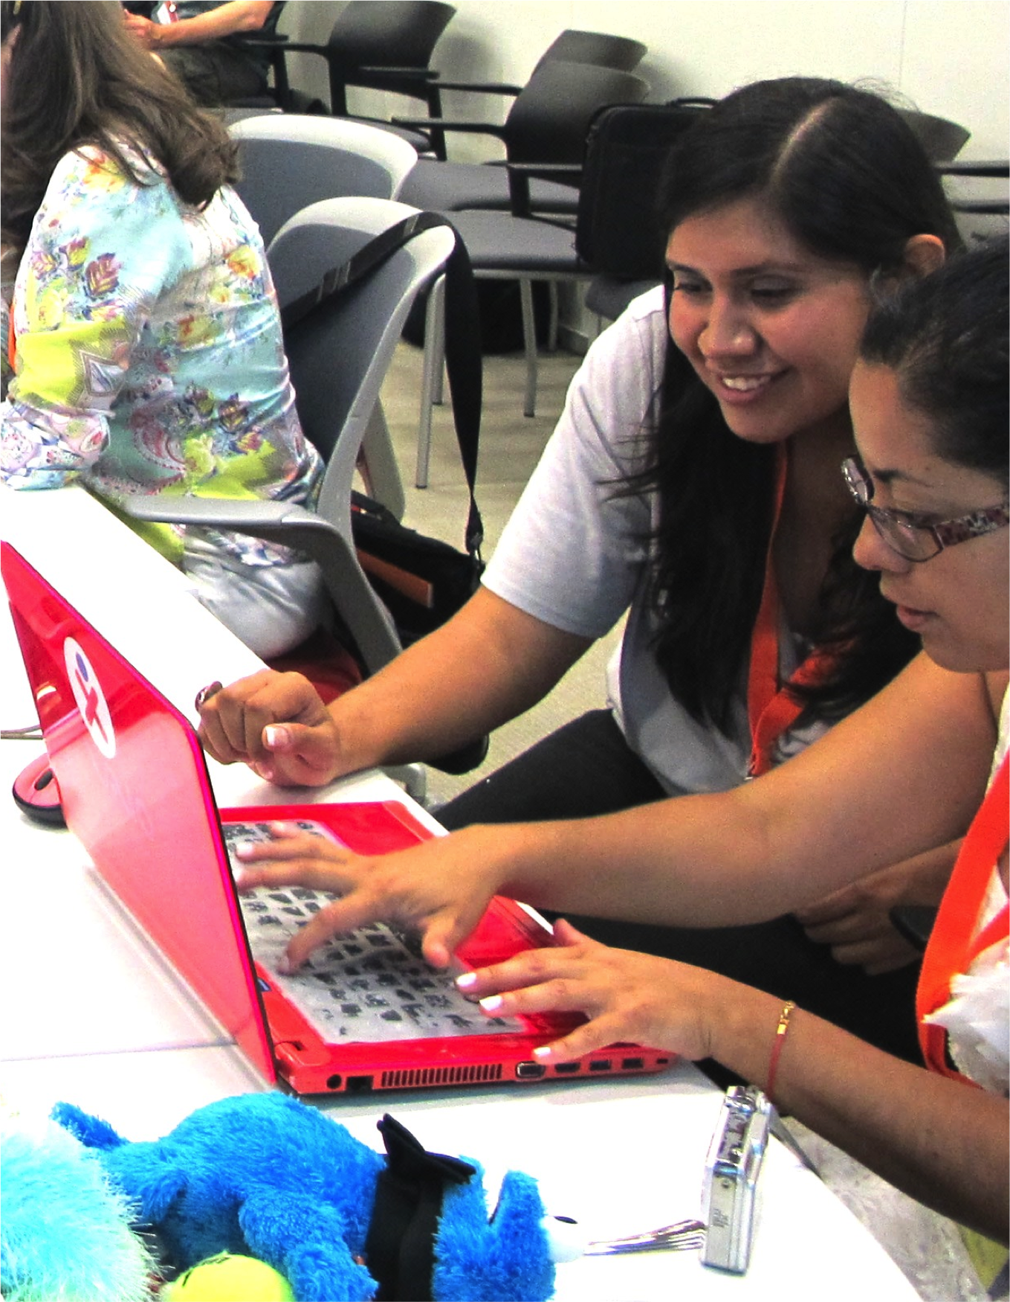

Slide 5
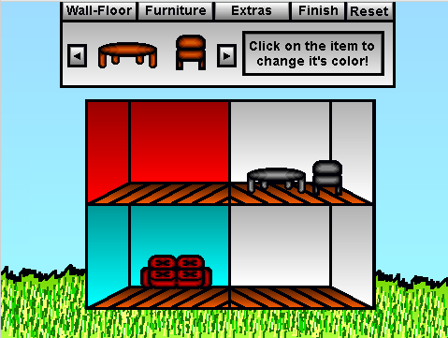

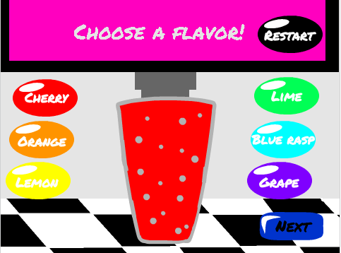
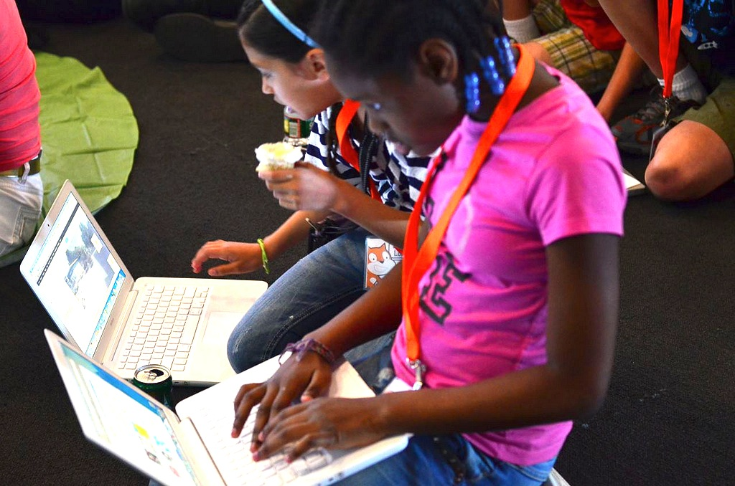
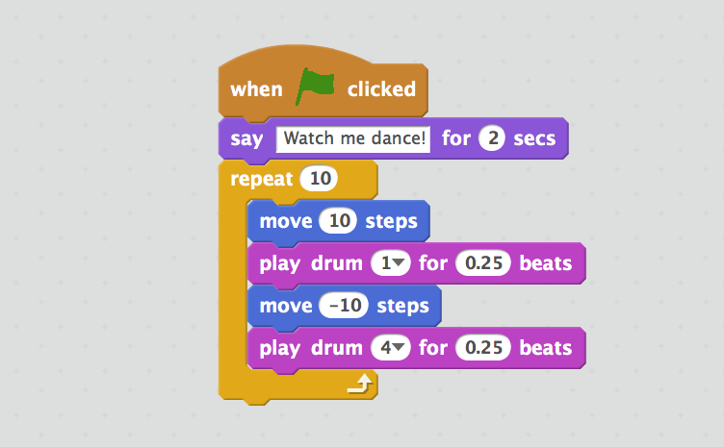
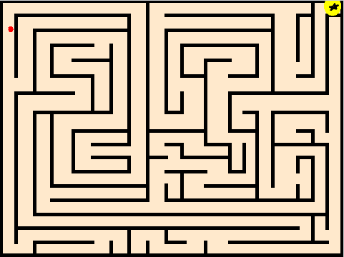
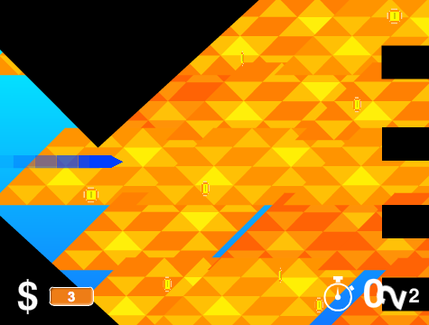
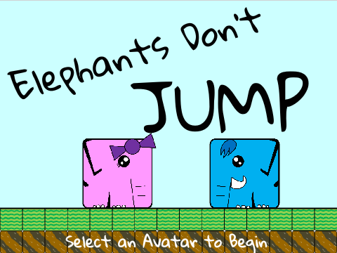
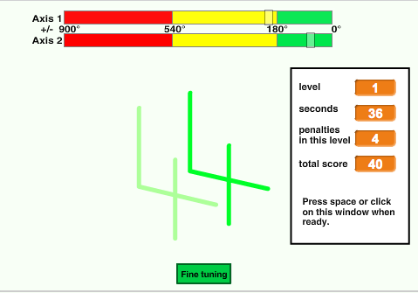

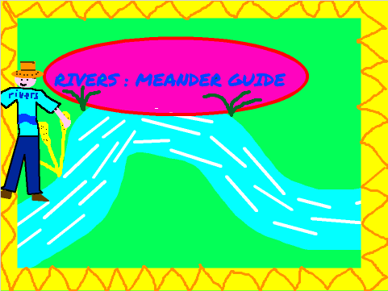
배경
창의 컴퓨팅 교과과정 안내에 오신것을 환영합니다!
창의 컴퓨팅 세계에 뛰어드는데 도움이 되고자 8가지 질문에 대해서 답을 마련했다.
1. 창의 컴퓨팅이란?
2. 스크래치란?
3. 본 교과과정 안내서는 무엇인가?
4. 본 교과과정 안내서는 누굴 위한 것인가?
5. 본 교과과정 안내서를 사용하기 위해서 필요한 것은 무엇인가?
6. 본 교과과정 안내서에 무엇이 포함되었나?
7. 본 교과과정 안내서를 어떻게 이용해야 하는가?
8. 본 교과과정 안내서는 어디서 나왔는가?
창의 컴퓨팅이란 무엇인가?
창의 컴퓨팅은 창의성이다.
창의 잠재력보다는 기술적인 면에 치중하여 어린 학생들의 관심과 가치와 동떨어지게 컴퓨터 과학과 관련 분야가 소개되었다. 창의 컴퓨팅은 창의성, 상상력, 흥미를 이끌어냄으로써 컴퓨팅에 대한 개인의 역량개발을 지원한다.
창의 컴퓨팅은 권한부여다.
컴퓨터에 많은 젊은 학생들이 디자이너나 창조자보다는 소비자로서 접근한다.
창의 컴퓨팅은 일상생활에서 매일 즐기는 역동적이며 인터랙티브한 컴퓨터 미디어를 창조하는데 필요한 지식, 숙련, 기본지식 함양을 강조한다.
창의 컴퓨팅은 컴퓨팅이다.
컴퓨터
컴퓨터 산출물을 생성하는데 참여하는 것은 어린 학생들이 컴퓨터 과학자와 프로그래머로서 경력을 쌓는 것 이상을 준비하도록 돕는다.
전 삶의 모든 면에서 전산 개념, 숙련 및 관점을 원리적이고 맥락적으로 신장하도록 어린 학생의 전산적 사고(Computational Thinking) 개발을 지원한다.

Slide 6
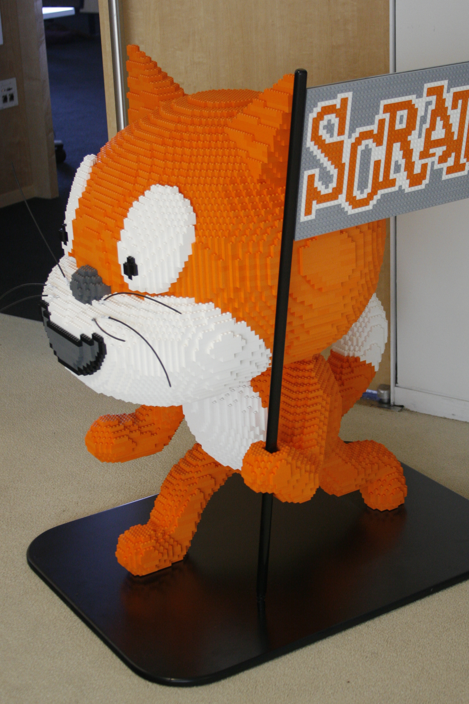
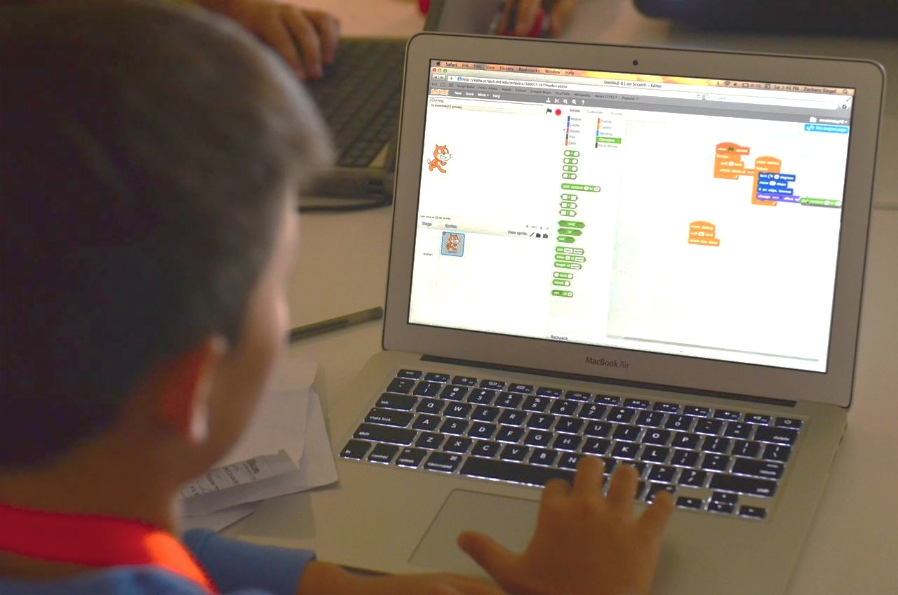
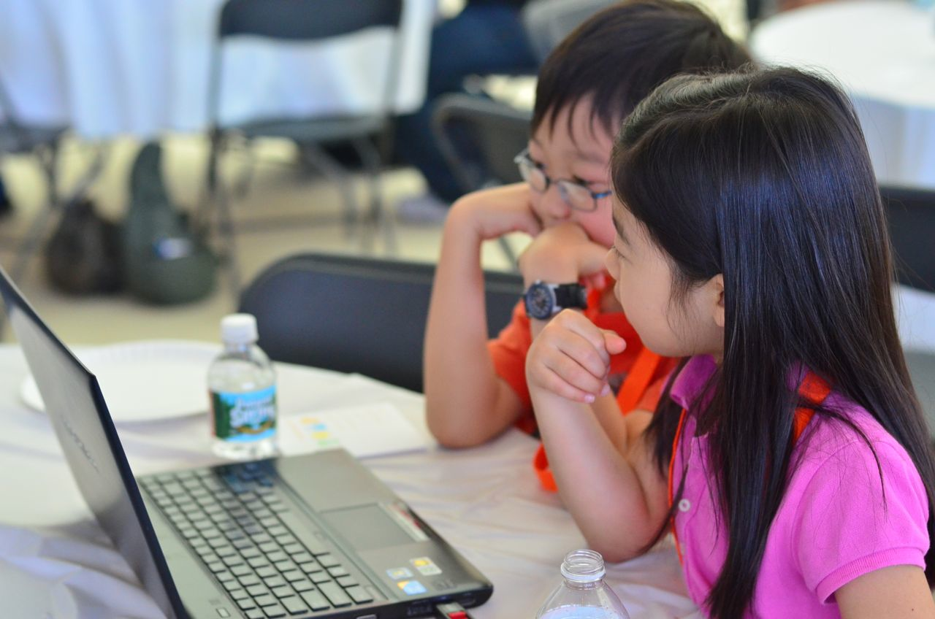
스크래치란?
창의 컴퓨팅을 위한 많은 도구가 있다. 본 교육과정 안내로 MIT 미디어랩 연구원이 개발한 무료 컴퓨터 프로그래밍 언어인 스크래치(Scratch)를 사용한다. 스크래치를 사용하여 애니메이션, 이야기, 게임 등 다양한 인터랙티브 미디어 프로젝트를 만들고 온라인 커뮤니티의 다른 친구들과 공유한다. 2007년 5월 스크래치가 소개된 이래로 전세계 수십만의 사람들이 6백만 이상의 프로젝트를 생성했다.
본 교과과정 안내서는 무엇인가?
스크래치 프로그래밍 언어를 사용하여 창의 컴퓨팅을 처음 경험하는 아이디어, 전략, 활동들을 본 교과과정 안내서는 담고 있다. 안내서의 활동은
This guide is a collection of ideas, strategies, and activities for an introductory creative computing experience using the Scratch programming language. The activities are designed to support familiarity and increasing fluency with computational creativity and computational thinking. In particular, the activities encourage exploration of key computational thinking concepts (sequence, loops, parallelism, events, conditionals, operators, data) and key computational thinking practices (experimenting and iterating, testing and debugging, reusing and remixing, abstracting and modularizing). Learn more about computational thinking – what it is and how to assess its development in learners – from resources in the appendix or by visiting http://scratched.gse.harvard.edu/ct
Inspired by constructionist approaches to learning, the activities in this guide emphasize the following principles:
PRINCIPLE #1:
CREATING
PRINCIPLE #2:
PERSONALIZING
PRINCIPLE #3:
SHARING
PRINCIPLE #4:
REFLECTING
Offer opportunities for learners to engage in designing and making, not just listening, observing, and using.
Offer opportunities for learners to engage in activities that are personally meaningful and relevant.
Offer opportunities for learners to engage in interactions with others as audience, coaches, and co-creators.
Offer opportunities for learners to review and rethink their creative practices.

Slide 7
Creative computing is for everybody!
WHO IS THIS GUIDE FOR?
No matter your current context or prior experience, this guide was designed with a wide range of learners and educators in mind. Here are a few examples of who might use the guide and how they might use it:
K-12 TEACHER
Scratch is being used in thousands of elementary, middle-school, and high-school classrooms around the world. The guide can be used in its entirety as a semester-long computing course, or selectively as part of other curricular areas. Many educators introduce creative computing as an after-school or lunch-time program, using the activities as inspiration and scaffolding for students’ open-ended explorations.
COLLEGE INSTRUCTOR
MUSEUM OR LIBRARY EDUCATOR
Scratch can serve as an introduction to fundamental computational concepts and practices, often followed by a transition to more traditional text-based programming languages in computer science courses. For example, the CS50 course at Harvard University uses Scratch as an introductory programming experience before transitioning to the C programming language. The activities have also been used as part of education, art, and media literacy courses at the college level.
In addition to formal learning environments like classrooms, Scratch has been used in informal learning spaces like museums and libraries. Whether as a structured workshop experience or a drop-in play space, these learning environments are ideal for supporting explorations in creative computing, without some of the restrictions present in traditional settings.
PARENT
YOUNG LEARNER
Parents can use the guide in a wide range of ways. From supporting homeschooling activities, to starting creative computing clubs at school, to hosting workshops at local community centers, parents are encouraged to think about how to use the guide to support the creative computing experiences of young learners.
Over the past seven years since Scratch’s launch, young learners have been passionate advocates for creative computing in a variety of settings. From introducing their parents and teachers to programming, to creating learning opportunities for their peers, creative computing can be something that is done with them or by them, rather than just for them.
WHAT DO I NEED IN ORDER TO USE THIS GUIDE?
In addition to time and an openness to adventure, some important resources include:
Computers with speakers (and, optionally, microphones and webcams): for the computer-based design activities
Network connection: for connecting to Scratch online (if your environment does not offer a network connection, a downloadable version of Scratch is available)
Projector or interactive whiteboard with speakers: for sharing works-in-progress and for demonstrations
Design notebooks (physical or digital): for documenting, sketching, and brainstorming ideas and plans
3

Slide 8
WHAT IS INCLUDED IN THIS GUIDE?
This guide is organized in seven units – from an initial preparatory unit to a culminating project-based unit – with each unit typically including six activities. A summary of each unit follows:
Create new interactive worlds through collaborative storytelling. Begin by developing characters, learning to code conversations, and then situating those characters and conversations in shifting scenes. Combine characters, conversations, and scenes in a larger story project that is passed along to other creators to further develop – and possibly reimagine entirely!
UNIT 3 - STORIES
Prepare for the culture of creative computing by exploring possibilities and setting up technical infrastructure (e.g., creating Scratch accounts, starting design journals) and social infrastructure (e.g., establishing critique groups). Dive into an initial creative experience by making something “surprising” happen to a Scratch character.
Connect fundamental game mechanics such as score and levels to key computational concepts, such as variables, operators, and conditionals. Analyze your favorite games, imagine new ones, and practice game design by implementing (and extending) classic games, like Pong.
UNIT 0 – GETTING STARTED
UNIT 4 - GAMES
Get comfortable with the key computational concept of sequence through a series of activities that provide varying levels of structure – from a step-by-step tutorial, to a creative challenge using a limited number of blocks, to open-ended explorations through making a project about yourself.
Before the culminating unit, take a moment to revisit work from prior units, further exploring advanced concepts or helping others by designing new activities or debugging challenges.
UNIT 1 - EXPLORING
UNIT 5 – DIVING DEEPER
Play with visuals and audio in these activities focused on animation, art, and music. Explore Scratch’s focus on media – and the key computational concepts of loops, events, and parallelism – by building your own band, designing animated creatures, and creating a music video for a favorite song.
Put all of the computational concepts and practices into action by designing and developing a project of your own through iterative cycles of planning, making, and sharing.
UNIT 2 - ANIMATIONS
UNIT 6 - HACKATHON
Assessment strategies are described throughout the guide, and several assessment instruments are included in the guide appendix. Our approach to assessment is process-oriented, with a focus on creating opportunities for students to talk about their own (and others’) creations and creative practices. There are many forms of process-oriented data that could be collected and various strategies are suggested throughout the guide, such as:
supporting conversations with and among students about their projects, recorded through audio, video, or text
examining portfolios of projects
maintaining design journals
We view assessment as something that is done with students, to support their understanding of what they already know and what they still want to learn. Assessment can involve a variety of participants, including the creators, their peers, teachers, parents, and others.

Slide 9
HOW SHOULD I USE THIS GUIDE?
We encourage you to use as much or as little of the guide as you like, to design new activities, and to remix the included activities. No matter your prior experience or expertise, we think of every educator as a co-designer of the Creative Computing experience. We would love to learn about what you’re doing, so we encourage you to document and share your experiences with us and with other educators via the ScratchEd community at http://scratched.gse.harvard.edu
USE AS MUCH
OR AS LITTLE AS
YOU LIKE
DESIGN
NEW
ACTIVITIES
REMIX
INCLUDED ACTIVITIES
CHOOSE
YOUR OWN ADVENTURE!
We are releasing this guide under a Creative Commons Attribution-ShareAlike license, which means that you are completely free to use, change, and share this work, as long as you provide appropriate attribution and give others access to any derivative works.
WHERE DID THIS GUIDE COME FROM?
This guide was developed by members of the ScratchEd research team at the Harvard Graduate School of Education – Christan Balch, Michelle Chung, and Karen Brennan. Jeff Hawson provided editing support and inexhaustible enthusiasm.
The guide contents draw on a previous version of the Creative Computing Guide (released in 2011) and on the Creative Computing Online Workshop (hosted in 2013). These were made possible with support from the National Science Foundation through grant DRL-1019396, the Google CS4HS program, and the Code-to-Learn Foundation.
We are enormously appreciative of the numerous educators who have used the previous version of this guide and participated in workshops. In particular, we would like to thank the educators who extensively tested the first guide (Russell Clough, Judy Hoffman, Kara Kestner, Alvin Kroon, Melissa Nordmann, and Tyson Spraul) and the educators who extensively reviewed the current guide (Ingrid Gustafson, Megan Haddadi, Keledy Kenkel, Adam Scharfenberger, and LeeAnn Wells).
We are also greatly appreciative of our collaborators. We would like to thank Wendy Martin, Francisco Cervantes, and Bill Tally from Education Development Center’s Center for Children & Technology, and Mitch Resnick from the MIT Media Lab for their extensive contributions in developing the computational thinking framework and resources. We would like to thank the many amazing Harvard Graduate School of Education interns who have contributed to the guide development over the past several years since the initial version in 2011, including Vanity Gee, Vanessa Gennarelli, Mylo Lam, Tomoko Matsukawa, Aaron Morris, Matthew Ong, Roshanak Razavi, Mary Jo Madda, Eric Schilling, and Elizabeth Woodbury.
5

